Slide 1
Securing Your Cloud Transformation
Territory Account Manager: Steve McManus
Notes:
Thanks and confirm time

Slide 2






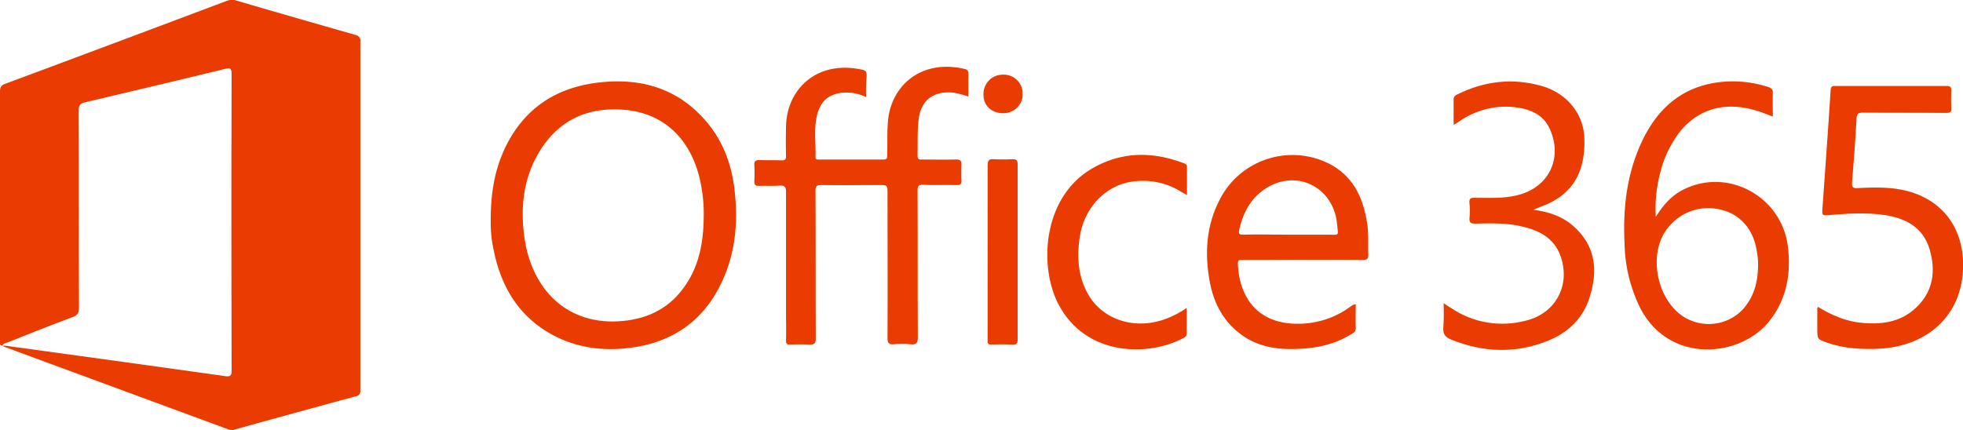




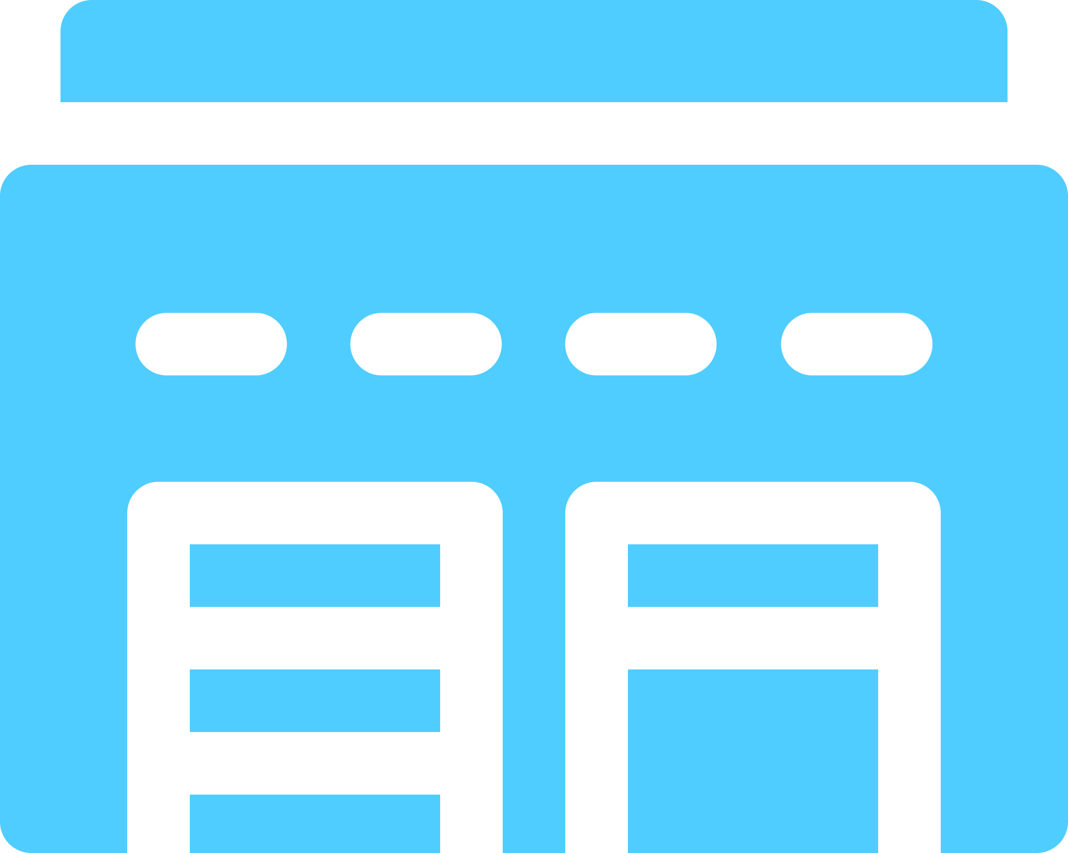




Zscaler: Powering digital transformation
Provide fast, secure, and reliable access to data no matter where it lives
Market Leader
Industry Leader
400
of the Forbes Global 2000
9
years in a row Gartner MQ Leader
Internet
SaaS
Global Scale
Operational Excellence
100B+
Daily transactions 150 data centers
10x Google searches
10+
years running an
inline security cloud
Digital Services Exchange
Factory
Data Center
80%
35x
70%
Faster User Experience
Fewer Infected Machines
Infrastructure Cost Reduction
Workforce
Customers

Slide 3

What sets Zscaler cybersecurity apart
SSL Inspection at scale
Cloud Effect
Purpose-built native proxy architecture blocks more threats
No longer need to ensure that your appliances have the bandwidth to handle all SSL traffic
Find once, block everywhere. Leverage AI and ML across 100+ billion daily transactions
PolicyNow™️
Policy follows the user across all locations
120K unique daily updates
60+ Threat Feeds
Always up-to-date so your team won’t have to and no changes windows or patch management
Threat sharing partnerships reduce risk, track outbreaks and improves insight
Notes:
The Zscaler platform performs about 120,000 unique security updates every day to keep our customers safe so your team won't have to. Difficult to stay up to date with appliances especially with the number of updates you need to do to keep up with the advanced threats (tough to do this daily).
We aggressively put protections in our cloud for all those new and emerging threats we find and share amongst our 60+ threat-sharing partners. For any threat that’s detected anywhere in the world on our cloud, protection is cascaded across the entire global cloud within seconds (find once block everywhere mentality”)
SSL : 96% of web pages are encrypted nowadays. To do SSL inspection at scale this requires a proxy (something we have invested heavily in being). A proxy allows you to sit in between SSL and inspect it. I'm a user going to the internet, my connection is going to terminate on to the Zscaler proxy and then Zscaler establishes the connection on my behalf out to the internet. Zscaler is in between the connection between me and anywhere i'm going- so we can see every packet coming and going and inspect that inside SSL (since were a cloud platform we can remove the burden off that from your / customer no longer needs to ensure the appliances have the bandwidth to handle this/ throw all the SSL at the zscaler platform and well handle it for you)
→ Cloud sandbox is another thing i want to highlight: we take an unknown file and put it into a secure environment and let that file run (simulated operating system), it will observe the behaviour of that file and report back and let you know if that file has done anything malicious or not (created files that are weird, creating outbound connections); value of it, if we find something for one of our customers, all other customers will get that protection

Slide 4
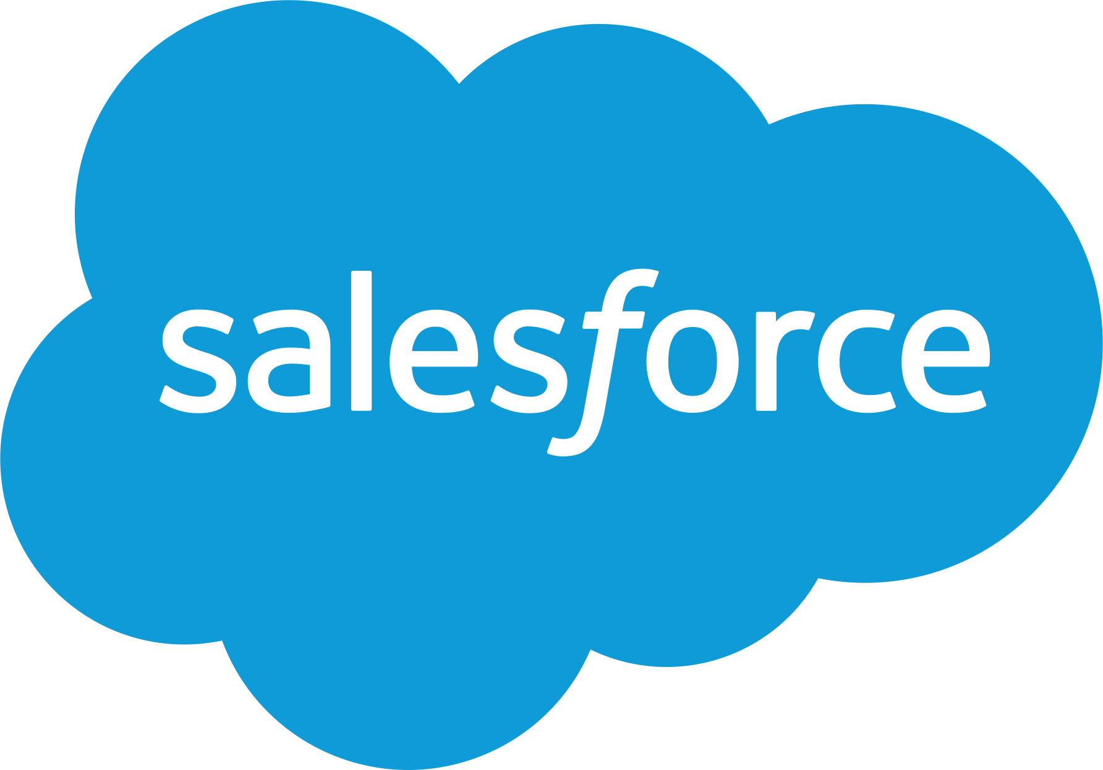





Zscaler Internet Access: Secure and fast access to internet & SaaS
Use Cases
External Apps
Office 365
Secure SD-WAN
App prioritization/peering with Microsoft
One-click deployment
Local breakouts for branch internet
API integration with SD-WAN vendors
Block Bad / Protect Good
Threat Protection
Data Protection
Protect Against Threats and Data Leakage
Inspect encrypted traffic at scale
Cloud-effect: Identify once, protect all
Shadow IT discovery
Protect IP / PII / Compliance
ID Provider
Standardization • Simplification • Identical Protection (mobile, branch, HQ)
Sydney
New York
London
Platform Services
Threat Prevention
Access Control
Data Protection
Broadband
Fiber
4/5G
Proxy (Native SSL)
Advanced Threat Protection
Cloud Sandbox
DNS Security
Cloud Firewall
URL Filtering
Bandwidth Control
DNS Resolution
Cloud DLP
Exact Data Match
CASB
Browser Isolation
Branch
HQ
Road Warrior
Your Workforce

Slide 5


Three architectures to secure SD-WAN
Local Breakouts with
UTMs / NGFWS appliances
Local Breakouts with
Virtual NGFWS
Local Breakouts with Cloud Security Platform
PRIVATE CLOUD
PRIVATE CLOUD
PRIVATE CLOUD
Branches
Branches
Branches
Poor security
Cost to buy and deploy
Management nightmare
Poor security
Poor user experience (backhaul)
Large attack surface
Unmatched protection all locations
Fast and direct user experience
Zero Attack Surface
Purpose-built cloud security platform is the best way to secure SD-WAN
Aligns with Gartner’s recommended SASE architecture – thin branch / heavy cloud
Notes:
3 architectures to secure SD-WAN
LOCAL BREAKOUT WITH UTMS & Next gen firewalls (can't deliver all the services, don't scale, have to make compromises on what inspection services you can enable, also break the bank putting the appliances everywhere, management nightwear - added appliances you need to update and control)
Local breakout with virtual next gen firewall - take your firewall and move them as a virtual appliance in the cloud (may seem like a good idea, but what you're doing it backhauling all your traffic to these firewalls which is basically the same as backhauling to your data center = poor security because appliances that are virtual cannot inspect SSL & are slow = bad user experience)/ increasing your attack surface (every firewall on your network increases your attack surface = more entry points)
Cloud security platform for local breakouts - taking direct internet, running it through the Zscaler cloud that has data centers across the globe - unmatched protection across all locations, fast & direct user experience because no backhaul reducing your attack surface ; full security stack as a service that scales across the globe and all the advantages of a cloud platform
Zscaler Cloud Firewall resolves these challenges in the same way the cloud proxy helps with web-based traffic. It enables fast and secure local internet breakouts for all ports and protocols, without any appliances to upgrade or deploy, all with centralized management. like the rest of the Zscaler platform, scales elastically with your consumption, and your cost is based strictly on the user count. With Zscaler, policies are not tied to a physical location. Instead, policies follow users to provide identical protection no matter what device they use, or where they connect. This means that your company’s executives have the same access and protections whether they are working in the corporate office, visiting branch offices, or traveling to meetings around the world.

Slide 6
Defining a New Market Category
Secure Access Services Edge
1
Compute power at the edge close to each endpoint
2
Branch with just a router and cloud security
3
Inline encrypted traffic inspection at scale
Notes:
SASE Report quotes on NGFW vendors”
Network and firewall vendors have a lack of proxy expertise. Many of the capabilities of
SASE will use a proxy model to get in the data path and secure the access. Legacy in-line
network and enterprise firewall vendors lack the expertise to build distributed, in-line proxies at
scale, risking higher costs and/or poor performance for SASE adopters.
Legacy vendors don’t have a cloud-native mindset. Hardware-centric network and network
security vendors will have difficulty adjusting to cloud-native and cloud-based services delivery.
Business models as well as salesforce and channel compensation will change. Vendors that
previously sold dedicated hardware on-premises will likely follow a path of least resistance and
deliver initial SASE offerings based on single-tenant architectures (virtual appliances dedicated
for each customer).

Slide 7


SD-WAN simplifies local breakouts, Zscaler secures them
External Apps
Internal Apps
PRIVATE CLOUD
SD-WAN
Routing / Switching
Optimize traffic paths
Cloud managed
Zscaler Cloud Platform
Advanced threat protection: SSL
Data protection: CASB/DLP
Access controls: CFW/BWC/DNS
Broadband / Cellular
SD-WAN
MPLS / WAN
Branch
Data Center
Notes:
Where we come together: SD-WAN simplifies how traffic is routed in the branch, and makes it easy to establish local Internet breakouts. However, connecting all branch locations directly to the Internet introduces significant security risks. Zscaler eliminates these risks by enabling customers to securely route all their Internet-bound traffic directly to the Zscaler Cloud Security Platform.
SD-WAN
Typically traffic goes Branch to data center through MPLS network then through the security stack and out to the internet
If i know that a chunk of my branch internet is destined for the internet, why am i spending so much backhauling it to the data center when i can just go direct to the cloud
SD-WAN sends the traffic up to the internet without sending it to the data center (reduce costs on MPLS)
Responsible for routing / switching & optimizing the traffic / typically cloud managed (not heavy footprint on end point)
Where Zscaler sits is on that direct internet and allows you to secure that - brings the whole security stack as a service - allow you to bring that into SSL ( inspect all your SSL traffic) we are able to do data protection (so you can control, make sure data isn't getting exfiltrated) bring casb and visibility into apps at the top, identify shadow IT, make sure files / file shares up there aren't maliciously exposed; then you can bring access controls to this traffic (cloud firewall, bandwidth control, DNS to bring a stroZscang security posture to your direct to internet traffic
Benefits of having both Silverpeak and Zscaler is that we work together to reduce cost & complexity, simplifying operations, ensuring you have a strong security posture with identical protection regardless of where they connect (one click configuration)

Slide 8

Zscaler is the only Microsoft certified security vendor for Office 365
Microsoft Networking Partner Program (MNPP)
Egress network
connections locally
Avoid network hairpins for mobile users
Differentiate Office 365 Traffic
1
2
3
Recommendation
150+ DCs for local breakouts
Peering in global datacenters
Direct access to Office 365
– no VPN backhaul
Prioritize Office 365 traffic over YouTube / internet traffic
Solution
“
I’m thrilled to see some of the largest enterprises including Sandvik, Siemens, and GE use Zscaler and Microsoft to deliver fast and direct access to Office 365, as well as applications running on Azure.
Notes:
Where are you on this journey? (sharepoint, skype, teams = need low latency connections)
Have you priced out the cost to upgrade firewall requirements needed for O365 growth? (Costly)
Have you had any complaints from your users since deploying O365?
We help a lot of businesses with either the deployment of O365 or when its already deployed but struggling to get the full value out of it)
From a partnership perspective we are the only security vendor that is certified by Microsoft as working with office 365 - (strategic partner)
Office 365 was designed to be deployed a different way from standard apps
Generates more traffic then typical applications (opens up multiple concurrent connections) / for example when you open up outlook, opens up 20 diff connections up to the microsoft cloud/ when you buy an appliance (rated by connections it can support / bandwidth etc) there is a max # of concurrent connection an appliance can handle
When business try to deploy office 365 the same way they've done other apps and run through the appliances they can't keep up (issues with performance) // 63% of people say they struggle with performance of o365 due to network performance problem
Going to O365 for collaboration - what value is it if you're not seeing the benefits of it (we’ve had businesses like Carlsberg saw an 100% growth in internet traffic with Office 365)
How are you supposed to deploy it (3 recommendations that Microsoft makes)
Microsoft says to egress network connections locally, instead of taking traffic and pointing it to DC, peel it off directly at the branch (local break out)
Zscaler supports that 150 data centers across the globe that allow you to go directly to the cloud and optimize connections between office and the microsoft cloud. We also peer with 40 microsoft data centers directly
Microsoft recommends: avoid network hairpins for mobile users (take a remote user, take them off the network and force them on a VPN Enback down only to go back up to the internet / hairpins = stiffles user experience)
Microsoft allows Zscaler to enable direct access to office 365 efficiently, get direct access with no VPN Backhaul
3rd recommendation - differentiate 0365 traffic make sure that that traffic is prioritized properly
Zscaler can help you do that with our bandwidth control (for office traffic, skype, sharepoint im going to give that priority but for youtube i'm going to give that a back seat so periods of contention on a direct internet connection when you need to make sure your critical apps are operating the best, you can throttle down youtube and give priority to business critical apps
People ask us: Why not go direct to internet without Zscaler in the middle:
When you break out traffic at the branch you need to secure that traffic (microsoft says send all ports and protocols to microsoft network so everything you should peel off) ; to do that you need security controls
Ensure traffic is optimized to ensure traffic is performing the best / optimizing to office 365 traffic (downloads / uploads working the best)
Prioritize your direct internet connection so your office traffic performs its best

Slide 9
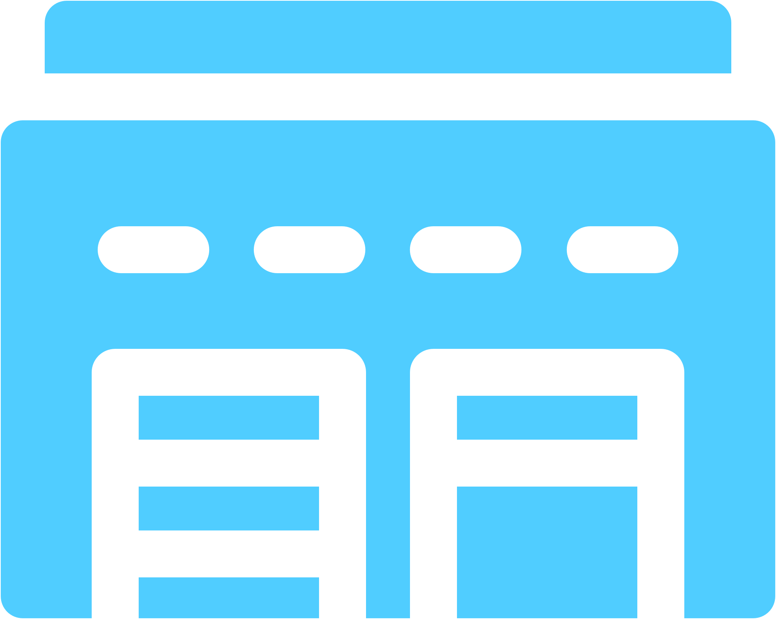



Achieve Zero Trust Network Access with Zscaler Private Access
Public
Private
Industrial Control
Use Cases
Replace Remote Access VPN
Direct Access to Multi-Clouds
Internal Apps
Fast, direct access to apps – no backhaul
Secure contractors’ connectivity to data center
No data center-to-cloud direct connect required
Eliminate the need for virtual DMZs
Accelerate M&A IT Integration
Secure Access to Industrial Systems
Integrate companies w/out integrating networks
Standardize security across companies
Secure critical infrastructure (invisible)
Policy-based access from anywhere
Protect apps/data; only allow authorized access
ID Provider
Data Center
Zero Attack Surface • App Segmentation • Zero Trust Network Access
Sydney
New York
London
Platform Services
Zero Trust Network Access
Discovery/ Availability
App/Device Access
Broadband
Fiber
4/5G
Anti-VPN
Anti-Firewall
Anti-DDoS
Anti-Network Segmentation
GSLB
Optimal Path Selection
App Health Monitoring
App Discovery
Browser Access
Web Isolation
Private Service Edge
Branch
HQ
Road Warrior
Your Workforce
Notes:
Product Line

Slide 10




Four areas where Zscaler can help you deliver value
Enhance security posture &
compliance
Protect the company’s increasing digital footprint
Provide customers and end-users a better experience
Reduce costs and ensure future cost avoidance
Reduction in risk of data breach / phishing
Visibility into all traffic
Policy-based access from anywhere
Inspect encrypted traffic at scale
Enable M&A agility
Fast and direct access to apps – no backhaul
Security and policy at the edge in 150 data centers (SASE)
100% cloud service – per-user subscription (no hardware required)
Consolidate and simplify IT
“It’s a rare occasion in history where it got more secure, better, and cheaper all at once.”

Slide 11



Why Zscaler cloud security platform?
Leading SaaS companies build their own multi-tenant architectures
Secure Access Service Edge
Compute at the edge – Fast, peering
Multi-tenant Architecture
Elastic scale, data privacy
Proxy Architecture
SSL inspection at scale
PRIVATE CLOUD
Products / Services
Platform Services
Zero Attack Surface
IPs/Network not exposed to the internet
Zero Trust Network Access
Native app segmentation
Workforce
Things
Customers
Operational Excellence
10+ years running an inline cloud service
Notes:
Zscaler platform
Having done 4 companies, 3 of them for security appliances.
stage of my life. Own investment
Purpose-built platform,
Multi-tenant, Extensible, APIs,
Two streams – listen to your customers. Don’t listen to them.
LB – standard policy – board. Is it enforced on boxes?
Policy – the next get request
Policy follow the user – innovation
Hybrid cloud – split sfdc?
Service edge – unlike sfdc

Slide 12











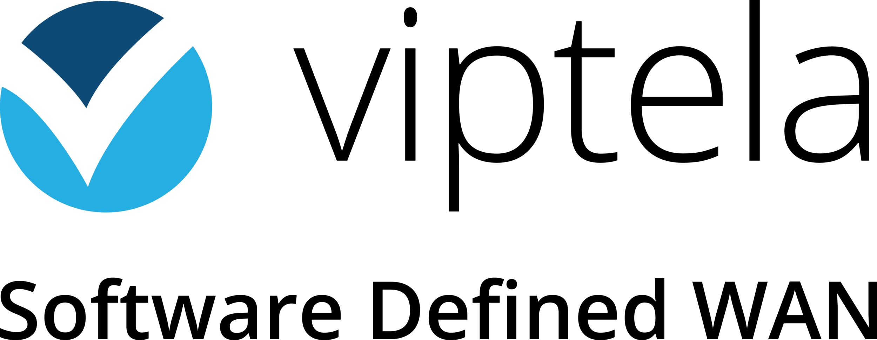






Blueprint for a cloud and mobile world
Better value: Easy deployment and operations
PRIVATE CLOUD
Identity Management
Security Operations
Digital Services Exchange
Security and Policy Enforcement
Endpoint Protection
Branch Networking
DC
Notes:
Partner eco-system
Z – one of the core areas – inline. Platform
Be the best. Say no to other areas,
Rep logos
Not a pseudo platform – SOC, endpoint, APIs
Casb – we are inline – so we do full inline Casb it is apart of the platform.

Slide 13






















Thought leaders…
Zscaler: Zenith of scalability
Protection
Across Countries
Locations
Protected
Users
Protected
Office 365
Monthly Traffic
185
30,000
1.3M
401 TB
150
6,000
400K
349 TB
113
1,800
200K
345 TB
70
900
120K
318 TB
All Traffic – All Users – All Locations
Conglomerates
Household & Personal Care
Apparel
Diversified Insurance
Beverages
Retail and Food
4
5
5
5
3
5
3
5
4
5
2
5
OF THE TOP
OF THE TOP
OF THE TOP
OF THE TOP
OF THE TOP
OF THE TOP
Notes:
Zscaler has been proven by some of the worlds largest brands to support these use cases.
Zscaler started with the goal of being the salesforce of cloud security. Scale was extremity important.
In fact, Zscaler stand for Zenith of Scalability. Let me highlight 4 dimensions of scale.
Protection across countries: Siemens has employees being secured by our cloud in over 185 countries
Locations protected: LDS has over 30K meetings houses all over the world that offer Internet services – we secure all of them.
User protected: MCNC: over 1.3 M users in North Carolina are secured by Zscaler – most of it being SSL traffic to YouTube.
YouTube hands down created more traffic on our network until late last year. Office 365 Traffic has now surpassed YouTube and account for 20% of our Internet traffic.
All companies will have a logo slide – many only sold a box being used for a department or small office. With a few exceptions, all employees form all locations go through Zscaler every day.
Adoption is not just across all industries. We have the largest organizations in the most verticals trusting Zscaler for their secure cloud transformation.
Broad Adoption Across Industries
Shown:
Household & Personal Care: P&G, Unilever, L’Oreal, Reckitt, Henkel
Conglomerates: Siemens, United Technologies, CK Hutchinsen, 3M (GE is #9)
Medical Equipment: Novartis, Sanofi (also have 6,7 and 8 on the list)
Beverages: ABInBev, Diageo, Heineken
Apparel – Kering
Chemicals: DowDuPont, BASF, Saudi Basic, Bayer, Linde, Air Liquide
Not shown:
8 of top 10 Conglomerates
7 of top 10 Chemical companies
4 of top 8 oil and gas
7 of the top 11 Retail and Food companies
5 of the top 8 Beverage companies
3 of the top 4 Apparel and Footwear companies
3 of the top 5 Diversified Insurance companies
5 of the top 5 Household and Personal Care companies
5 of the top 8 Medical Equipment and Supplies

